Slide 1
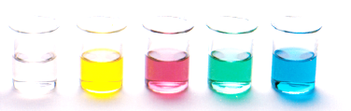
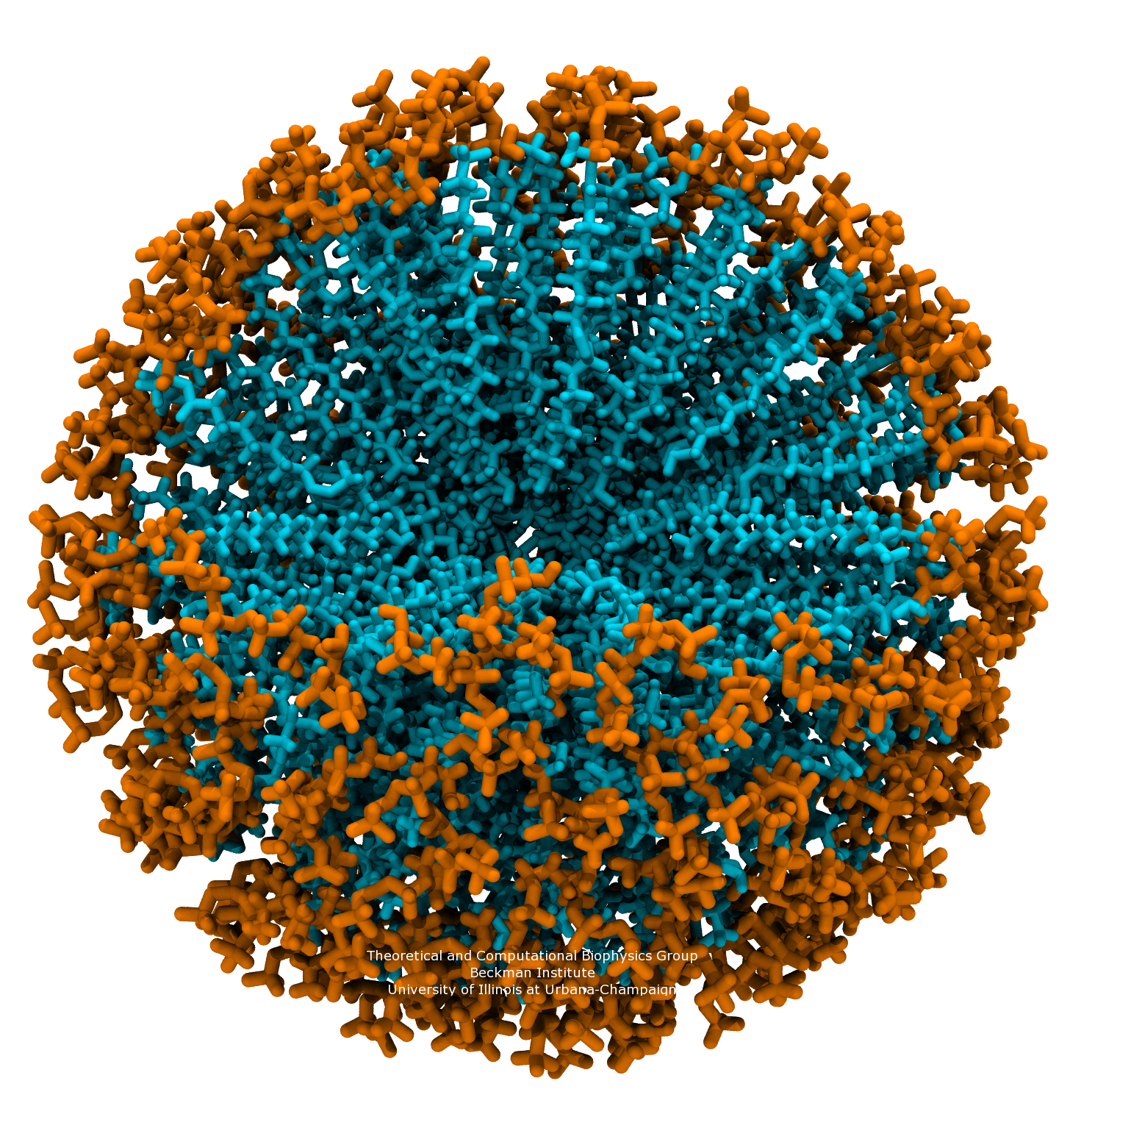
Properties of soap
Review – fatty acids, triglycerides and saponification
Properties of soaps and detergents
Resources
  Essential chemistry, ch 12.6

Slide 2
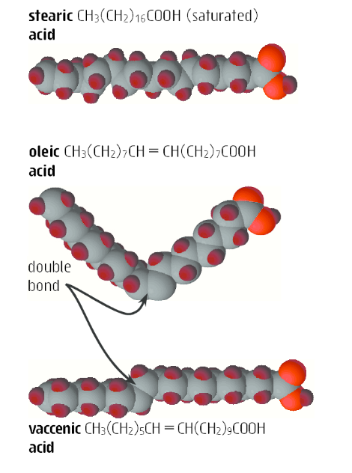
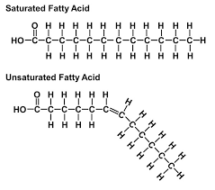
Review – fatty acids

Slide 3
Review – fatty acids
Fatty acid: A carboxylic acid derived from hydrolysis of animal fats, vegetable oils, or membrane phospholipids.
  Nearly all have an even number of carbon atoms, most between 12 and 20, in an unbranched chain.
  The three most abundant are palmitic (16:0), stearic (18:0), and oleic acid (18:1), where the first number is the number of carbons and the second is the number of double bonds in the hydrocarbon chain.
  In most unsaturated fatty acids, the cis isomer predominates; the trans isomer is rare.
  Unsaturated fatty acids have lower melting points than their saturated counterparts; the greater the degree of unsaturation, the lower the melting point.

Slide 4
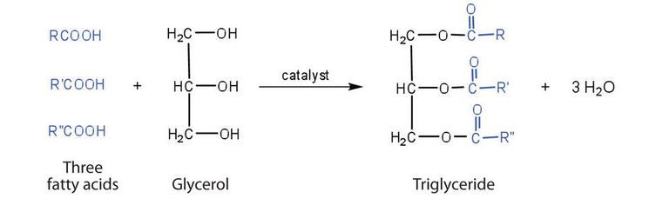
Review – triglycerides
Esterification reaction between glycerol (1,2,3-propantriol) and three fatty acids gives a triglyceride
Triglyceride is another name for fats and oil

Slide 5
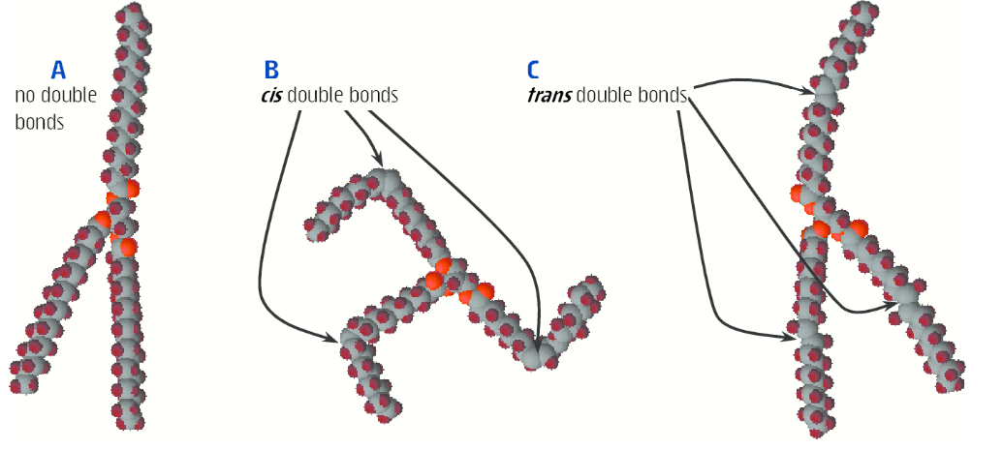
Review – triglycerides
Triglyceride - Physical properties depend on the fatty acid components.
  Melting point increases as the number of carbons in its hydrocarbon chains increases and as the number of double bonds decreases.
  Oils: Triglycerides rich in unsaturated fatty acids are generally liquid at room.
  Fats: Triglycerides rich in saturated fatty acids are generally semisolids or solids at room temperature.

Slide 6
Review – triglycerides
The lower melting points of triglycerides rich in unsaturated fatty acids are related to differences in their three-dimensional shape.
Hydrocarbon chains of saturated fatty acids can lie parallel with strong dispersion forces between their chains; they pack into well-ordered, compact crystalline forms and melt above room temperature.
Because of the cis configuration of the double bonds in unsaturated fatty acids, their hydrocarbon chains have a less ordered structure and dispersion forces between them are weaker; these triglycerides have melting points below room temperature.

Slide 7
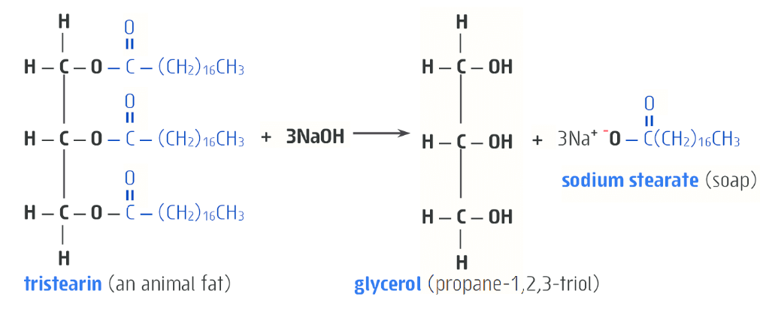
Saponification
Natural soaps are prepared by boiling lard or other animal fat with NaOH, in a reaction called saponification (Latin, sapo, soap).

Slide 8
Cleaning action of soap
Soaps clean by acting as emulsifying agents:
  Their long hydrophobic hydrocarbon chains are insoluble in water and tend to cluster in such a way as to minimize their contact with water.
  Their polar hydrophilic carboxylate groups, on the other hand, tend to remain in contact with the surrounding water molecules.
  Driven by these two forces, soap molecules spontaneously cluster into micelles.

Slide 9
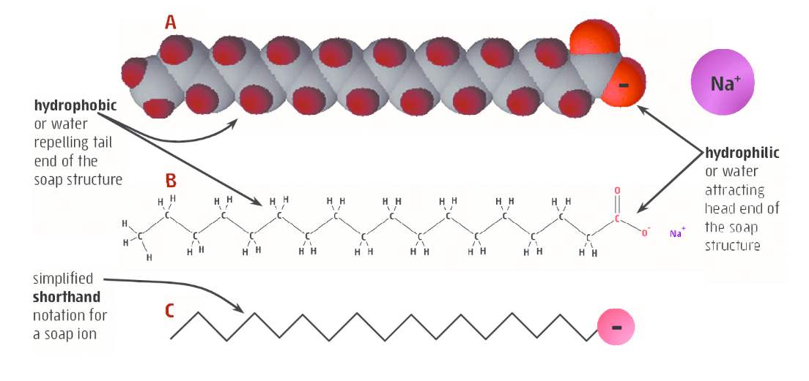
Cleaning action of soap

Slide 10
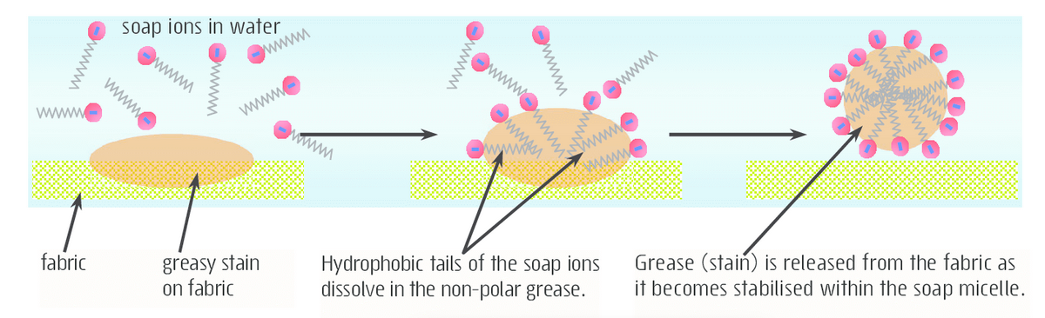
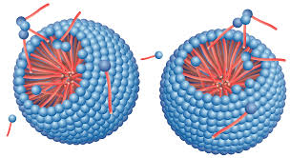
Cleaning action of soap
Micelles are 3D structures

Slide 11
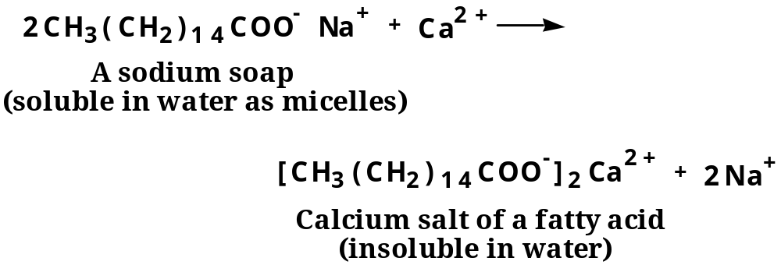
Soap in “hard water”
Soaps form water-insoluble salts when used in water containing Ca(II), Mg(II), and Fe(III) ions (hard water)

Slide 12
Detergents
Synthetic detergents are often used instead of natural soaps
The design criteria for a good detergent are:
  a long hydrocarbon tail of 12 to 20 carbons.
  a polar head group that does not form insoluble salts with Ca(II), Mg(II), or Fe(III) ions.
The most widely used synthetic detergents are the linear alkylbenzenesulfonates (LAS).

Slide 13
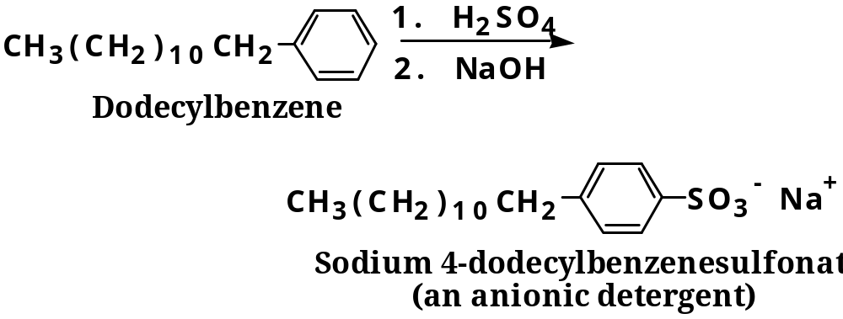
Detergents
Synthetic detergents are cheaper and more readily available as they are made from petroleum products rather than animal fats and plant oils

Slide 14
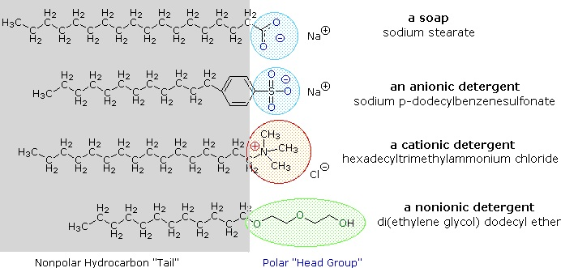
Detergents

Slide 15
On going work
This concludes Essential Chemistry chapter 12!
Complete Set 18, Essential Chemistry

